Slide 1

BIOEAST
Central and Eastern European Initiative for Knowledge-based Agriculture, Aquaculture and Forestry in Bioeconomy
Sustainable Farming Conference – Hungarian Chamber of Agriculture
18 October 2017, Budapest
Anikó Juhász and Barna Kovács

Slide 2
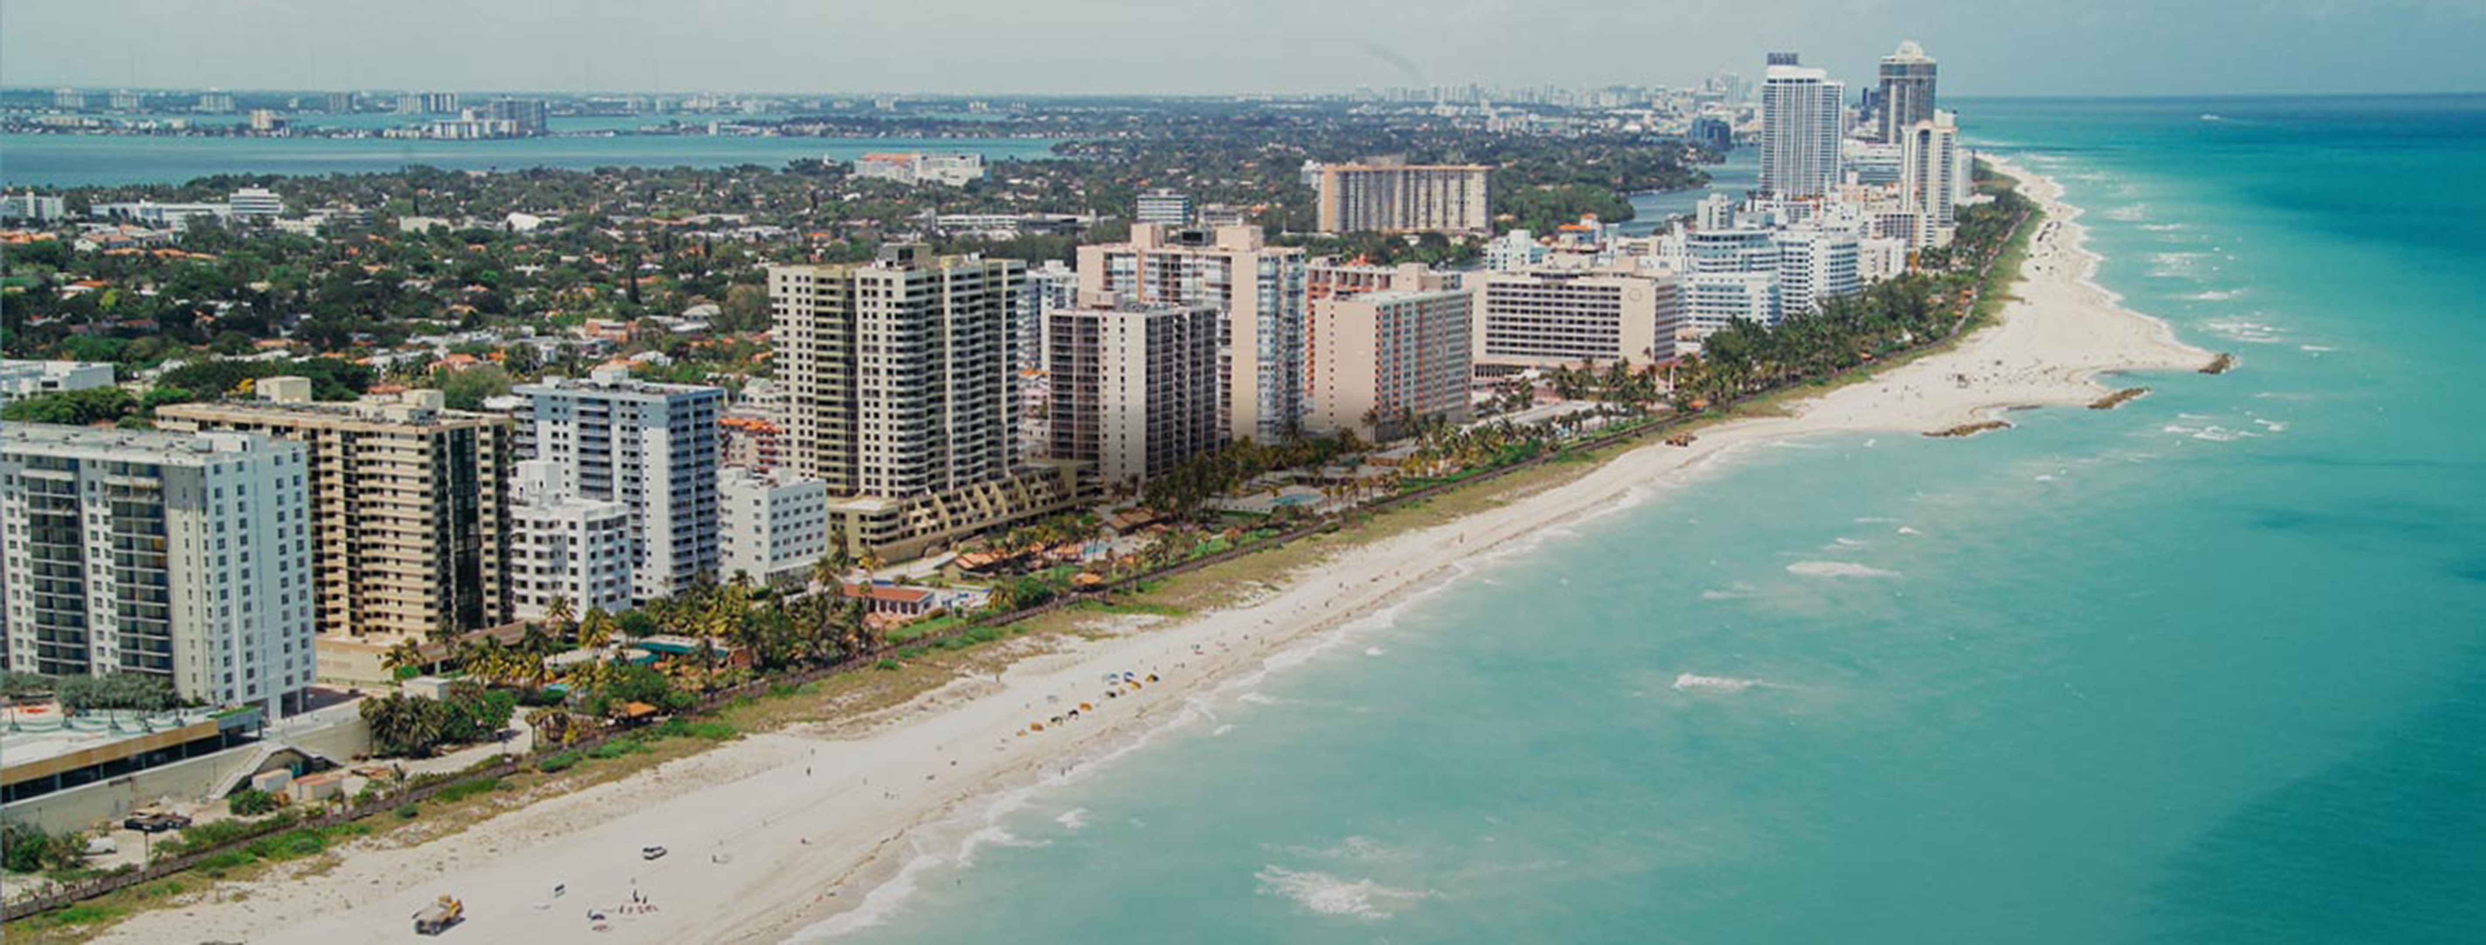
Why BIOEAST?
  Are the Central and Easter European Countries prepared for solving their sustainability challenges in agriculture?
  Research and innovation based approach
  Cooperation and system approach (multi-actor, transdisciplinary and cross-sectoral)
  Macroregional approach

Slide 3
Research and innovation based approach?
FP7 KBBE low EU13 participation

Slide 4
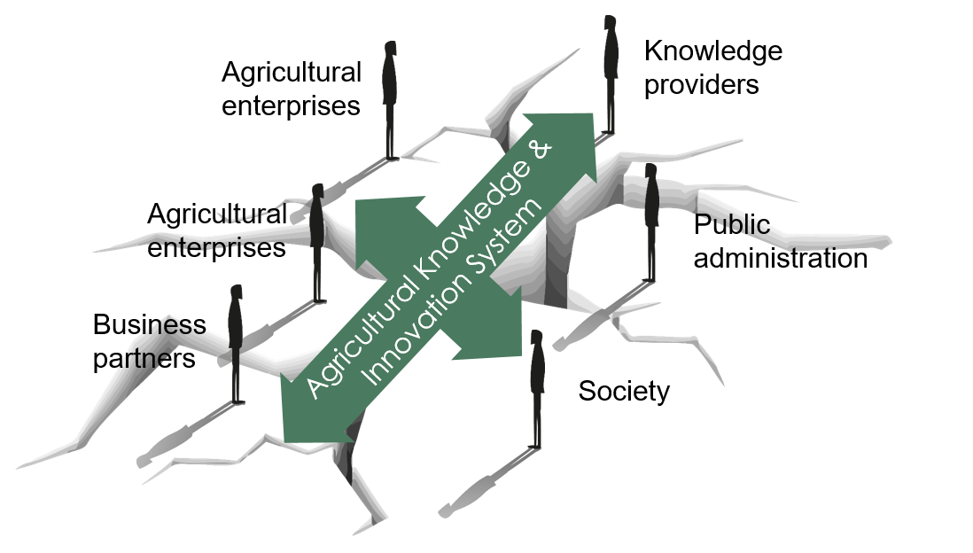
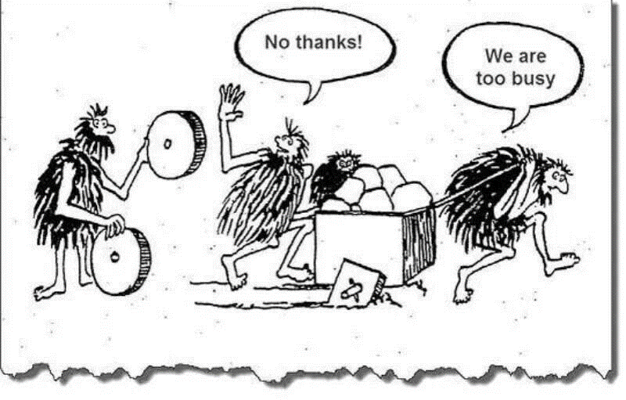
Cooperation and system approach?
The need to build trusted relationships
Sympathy
Trust
Mistrust
Respect
n= 769
n= 1468
Low - Level of Loyalty – Will do! - High
Sholtes model in Hungary (2015)
n= 2979
n= 686
Low - Level of Capability – Can do! - High
Source: Baranyai Zsolt (2017) research in lead by Szabó G. Gábor and helped by HCA
Notes:
For trust we need soft skills:
More listening oriented
Tailoring the breadth of information to the specific farm conditions and aspirations of the farmer
Accompanying peer-to-peer processes as a facilitating specialist
For trust we need hard skills:
Knowledge on farming and production techniques
Stepping up advisory and farmer competences and digital tools enabling the multiple use of data
How to combine – „be the best clever friend in the neighbourhood”
Face-to-face and on-farm: tuning blended learning to the farm context, being impartial and having the ability to change

Slide 5


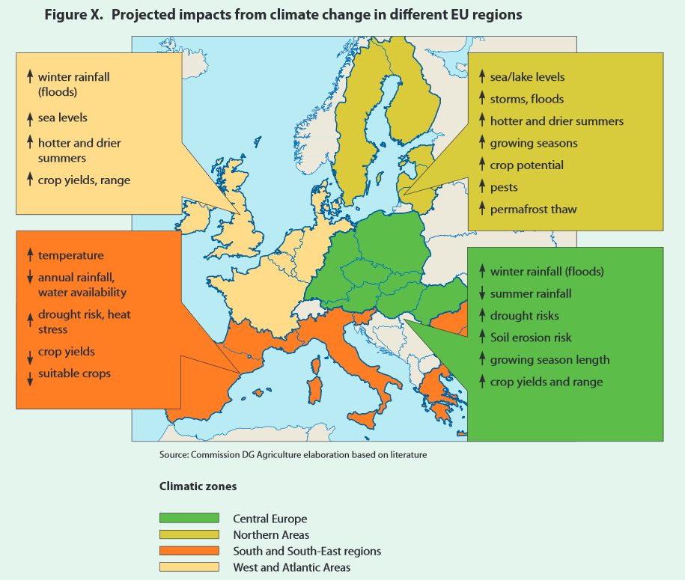
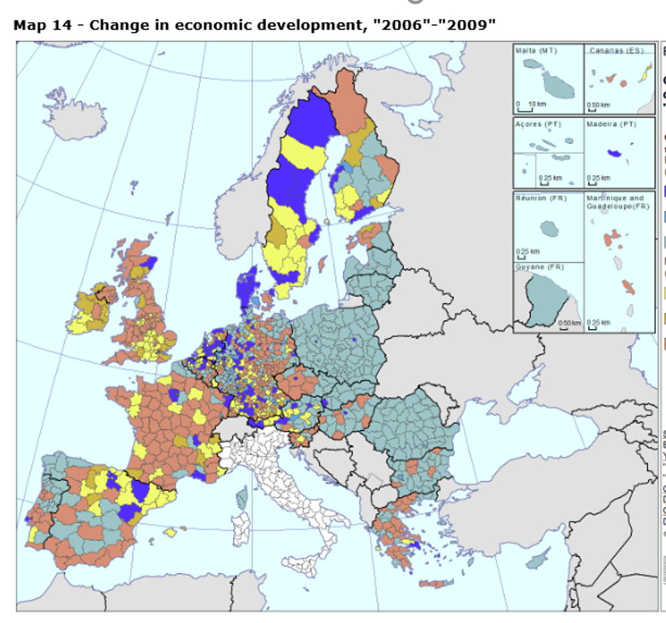
Macroregional approach?
We have specific challenges
Theme 1: Climate change challenges in the Continental &Boreal Bio-geographical Regions
Theme 2: Policy and governance challenges in the Continental & Boreal Bio-geographical Regions
Notes:
How can we use BIOEAST RI focus areas?
Focused
Strategies: national, regional, sectoral, institutional
EIP: supporting the implementation
H2020: lobbying for specific calls
Lobby for other funds

Slide 6
Objective and actions
To improve the sustainable growth of knowledge-based agriculture, aquaculture and forestry in the bioeconomy in the CEE regions.
  Initiate cooperation
  Provide evidence base for strategies
  Define research needs
  Improve skills
  Develop funding synergies
  Increase visibility

Slide 7
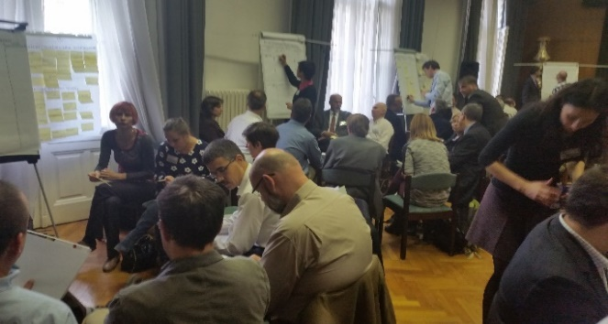
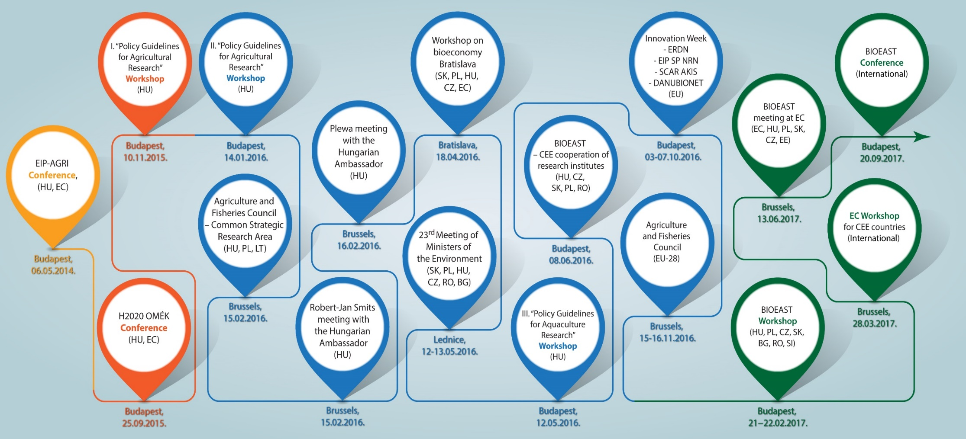
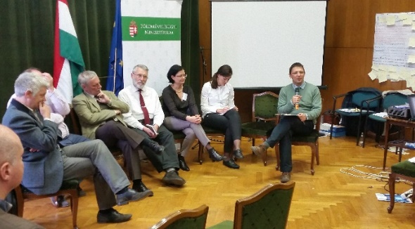
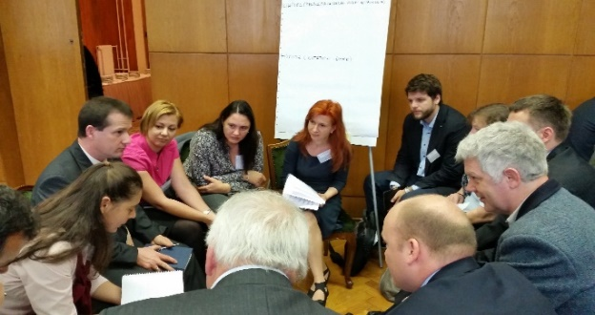
Initiate cooperation
Networking events
Notes:
EIP results:
Generally the difficulties of cooperation, lack of trust and information,
Complicated administrative system
Scarcity of farmer oriented scientific experts were identified as key challenges
Workshop I. results:
- 7 sections, 46 relevant problem areas, 63 focus areas (research topics) have been defined.
110 organizations were named by those present, 2/3 of which being international relations.
Workshop II. results:
The farmers supported most of the focus areas identified by the researchers.
They extended these areas in every case.
The attendants produced 60 project ideas
Workshop III. results:
Involvement in SCAR fish
Awereness raising among „fish” reasearchers
Land locked countries and freshwater aquaculture – lobbying objective
Workshop regional series with NAK
-

Slide 8
Define Research an Innovation focus areas
Theme 1: Climate change challenges in the Continental Bio-geographical Regions
Sustainable intensification by maintaining soil conditions and improving water management;
Sustainable extensification by maintaining biodiversity and ecosystem services;
Improvement of organic farming in terms of production technology;
The reduction of high dependence on non-renewable energy sources;
Exploiting the potential for protein crop production;
Strengthen the Region as a buffer zone against emerging and changing pathogens;
Sustainable, efficient and competitive freshwater fish production.

Slide 9
Define Research and Innovation focus areas
Theme 2: Policy and governance challenges in the CEE countries
Motivating knowledge-based modern farming and cooperation among farmers;
Supporting the generation change of the first entrepreneurs in the agri-food sector;
Improving supply chain efficiency and increasing its added value;
Increasing consumer awareness in mistrustful and price sensitive societies;
Increasing the value added use of agricultural and forestry biomass;
Experiences of less developed EU regions in social integration challenges such as food, energy or social care security.

Slide 10
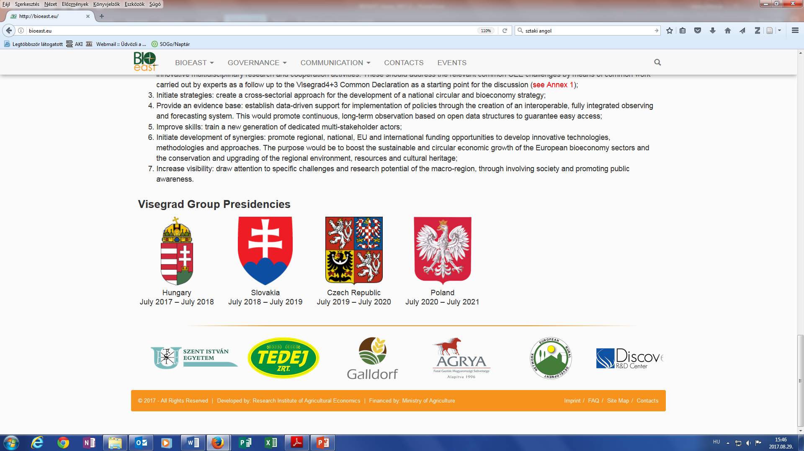
Provide evidence base
Survey on capacity building needs
Type of organisation
The respondents are mainly from Visegrad 4 countries.
 | number | %
Business | 10 | 9,9
Research | 63 | 62,4
Public | 28 | 27,7
Total | 101 | 100,0
24
29
7
9
Other countries of origin: Romania, Slovenia, Croatia, Bulgaria, Germany, Montenegro
Main reasons of interest for Bioeconomy in the CEE region:
Networking, joint scientific work, new cooperation opportunities
Need of sustainable development of agriculture

Slide 11
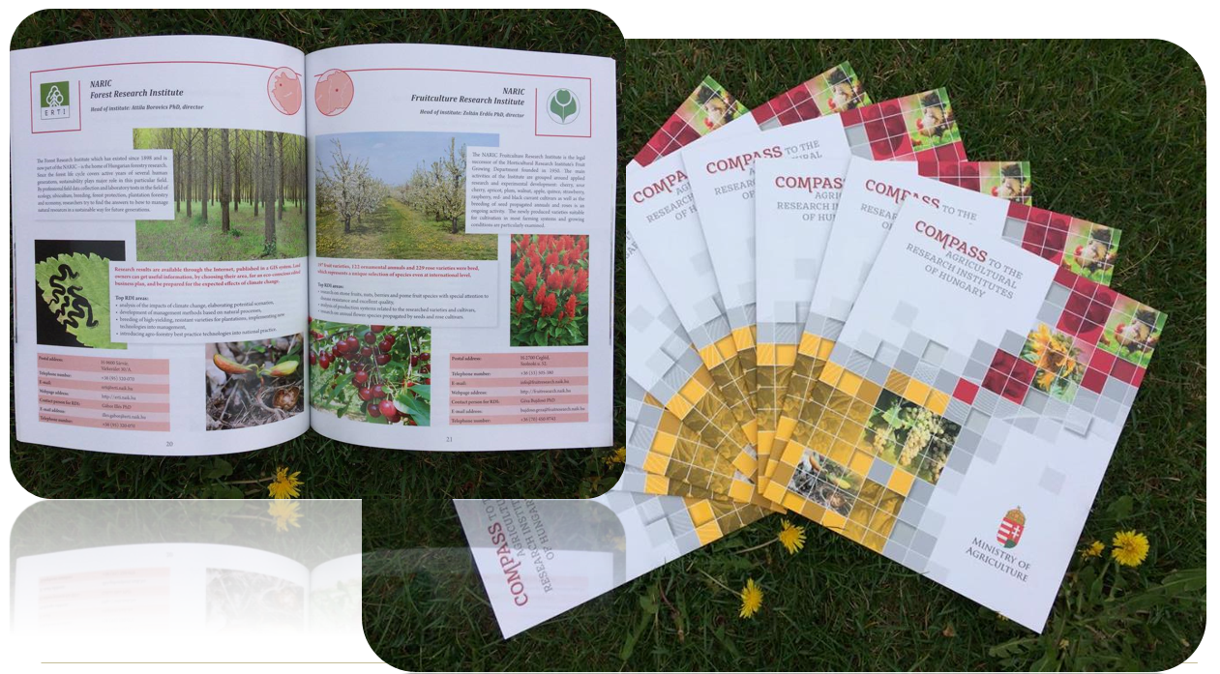
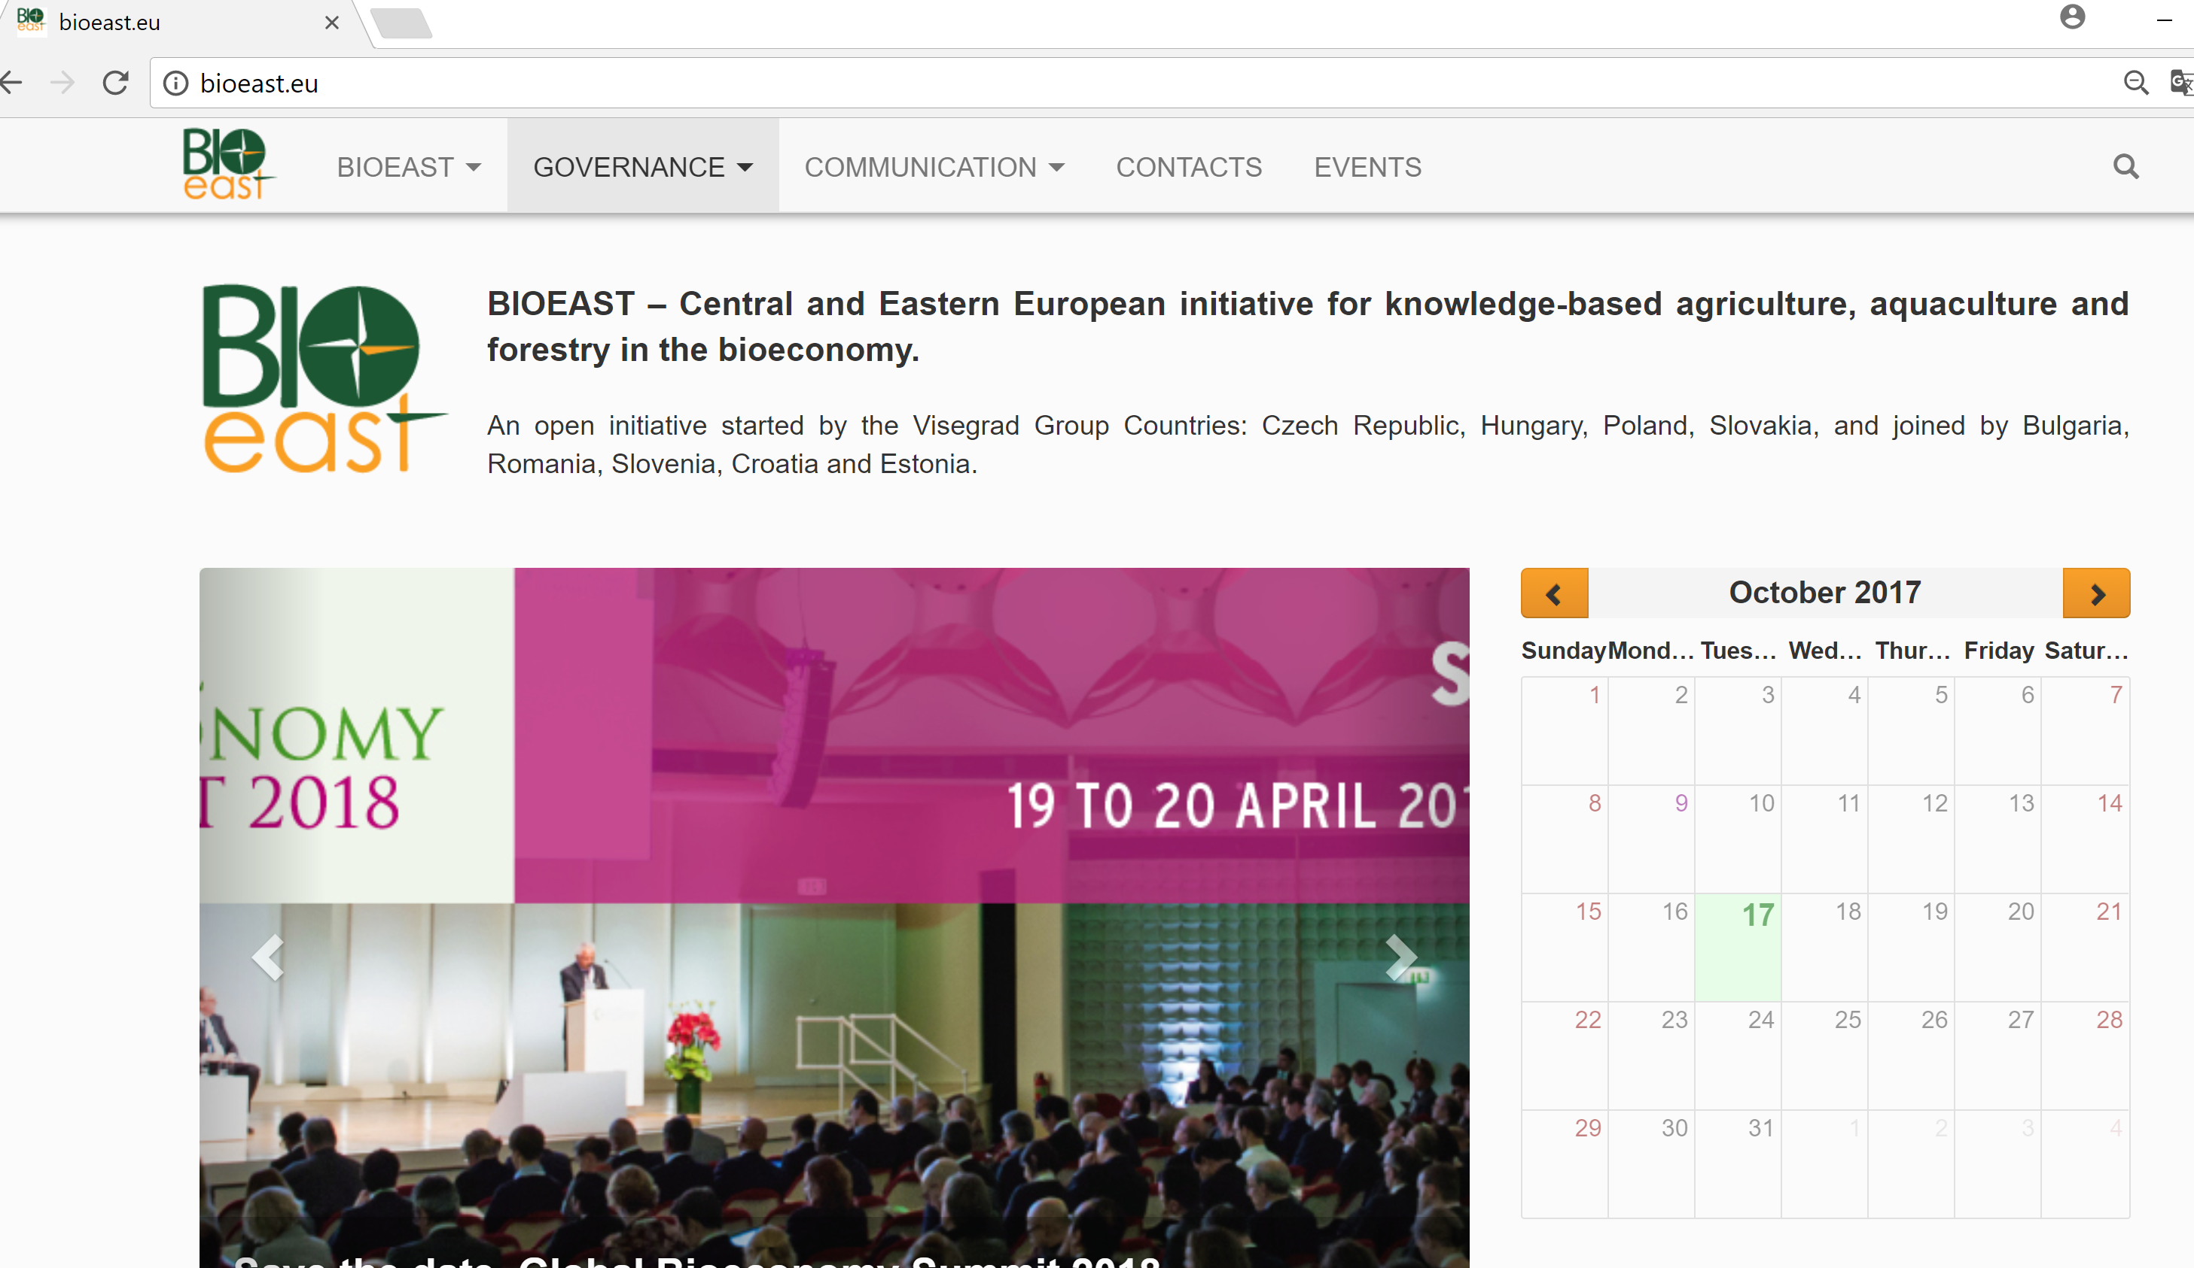
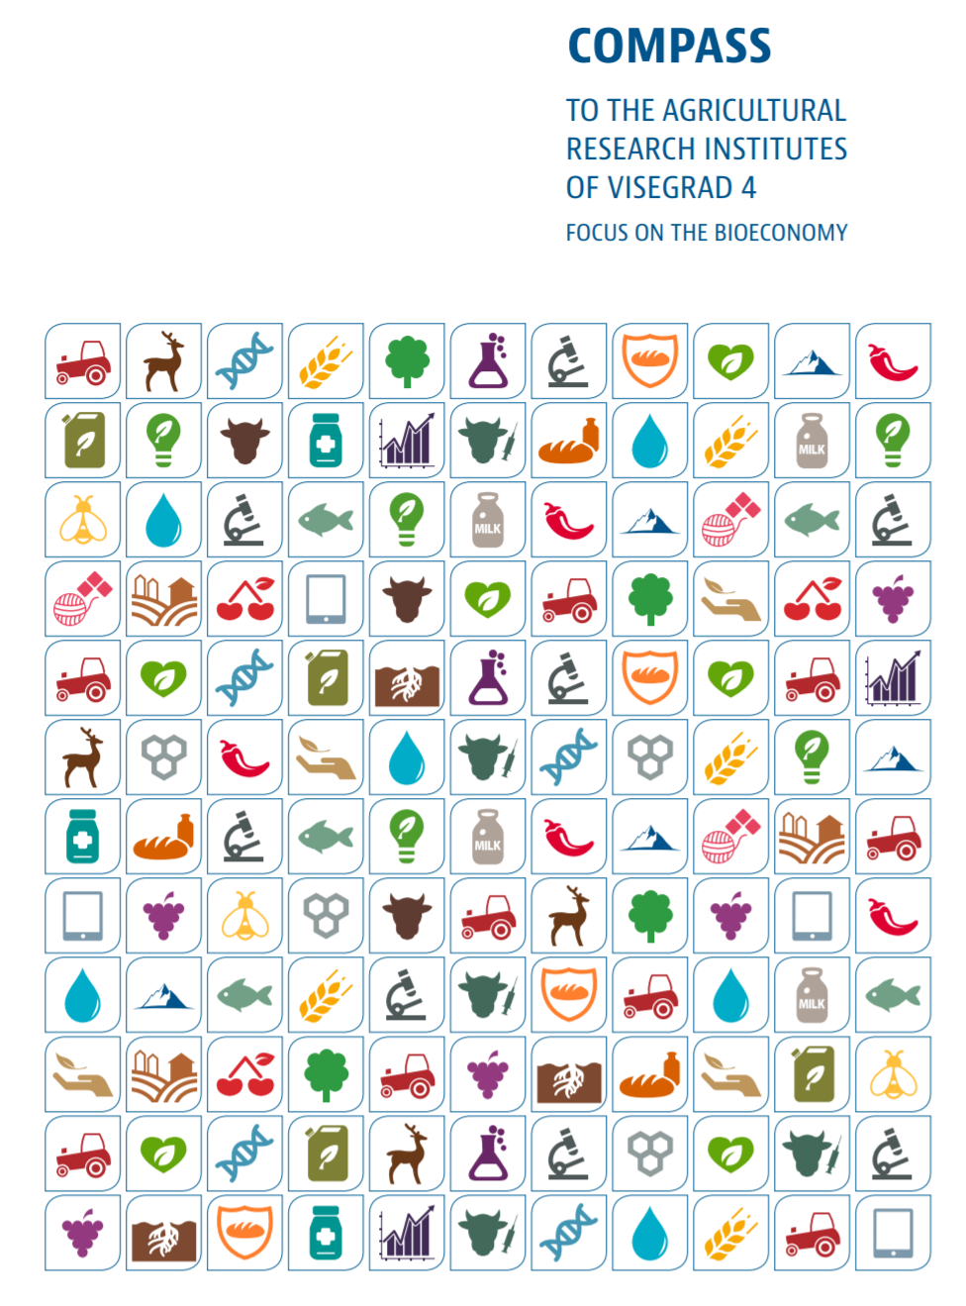
Increase visibility
Already started:
Developing a portal
Publishing a CEE bioeconomy research catalogue
Still ahead of us:
Newsletter
More active brokerage

Slide 12

Our objective – Build our own CEE tower
To improve the sustainable growth of knowledge-based agriculture, aquaculture and forestry in the bioeconomy in the CEE regions.
  Initiate cooperation
  Provide evidence base for strategies
  Define research needs
  Improve skills
  Develop funding synergies
  Increase visibility
www.bioeast.eu
Join us!

